Slide 1
Before we start …
Enjoy the music – who is the composer?
Be ready to introduce yourself to the class (briefly)
  Name + anything you like: where you work?; interest in AI?
1st Seminar programme:
  10:00 – 11:10 (70m) Brief history of AI; Basic principles of rule-based reasoning in law
    10 minutes refreshment break
  11:20 – 12:30 (70m) Basic principles (cont.); Representing legal knowledge with the DataLex software
    Another 10 minute refreshment break
  12:40 – 1:10 (30m) Discussion for as long as desired

Slide 2
Graduate Diploma in Legal Professional Practice PLTX2040 Practicum (Technology and Innovation)
An introduction to rule-based AI in law
Philip Chung & Graham Greenleaf
UNSW Faculty of Law
28 May 2020
DataLex inferencing software by
Andrew Mowbray
UTS Faculty of Law & AustLII

Slide 3
Aims
1st Seminar
  What are the landmarks in the history of AI?
  Which types of AI suit most applications to law? What implications does this have?
  Introduce rule-based reasoning (backward and forward chaining)
2nd Seminar
  Key elements in building DataLex apps: writing KBs (knowledge-bases) + integrating them with AustLII resources
  Demonstration: How to build your own small KB / app
  Practice: Hands-on to build & test your own apps using the DataLex KB tools, software and AustLII resources

Slide 4
Artificial intelligence: Brief history
1950s – aim to create general intelligence (‘strong AI’)
  Always fails (‘easy things are hard’: Minsky) – cup of coffee?
  Supporters keep claiming it is imminent (‘singularity’)
  AI successes are always in ‘weak/narrow AI’ – expert domains
Split between two main schools of AI at that time
  Symbolic AI : rules (symbolic logic) manipulating symbols of real entities; suits high level language and logical tasks;
    Statistical AI: An intermediate stage more than a third paradigm?
  Sub-symbolic AI: simulations of neurons, with multiple inputs (weighted) resulting in one composite output which ‘fires’ once over a set threshold; suits ‘low level perceptual tasks’
  Symbolic AI dominant until 90s, sub-symbolic (neural nets) since then.

Slide 5
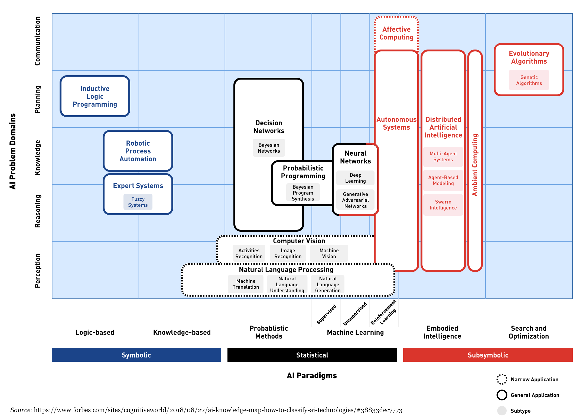
AI paradigms (one of many versions)

Slide 6
Artificial intelligence: Brief history (2)
Reasons for rise of neural networks since mid-1980s
  Multi-layered neural networks + ‘back propagation’ of fault, worked on more tasks; but no ability to explain results
  ‘Parallel distributed processing’ + more processing power
  Machine learning (ML) enhanced by vast post-Internet (1995) sources of ‘Big data’, for training sets, and real tasks
Landmarks in neural networks and ML (almost all in the last decade)
  NOT 1997 IBM’s Deep Blue beat Kasparov at chess (brute force); 2011 IBM’s Watson won Jeopardy! (smart retrieval) – best known AI but minor effect
  2012 Convolutional neural networks (ConvNets) won ImageNet competition, revolutionised image recognition
  2012 automated speech recognition using multiple deep neural nets –> first great natural language processing (NLP) success
  2016 ‘neural machine translation’ (Swiss) replaced Google, Microsoft etc

Slide 7
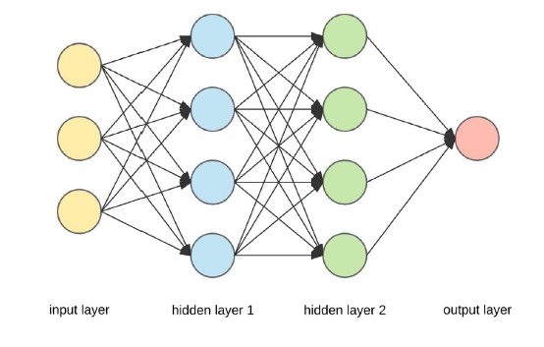
Neural network with two hidden layers
(Figure by A Dertat, cited in Legg & Bell, p10)

Slide 8
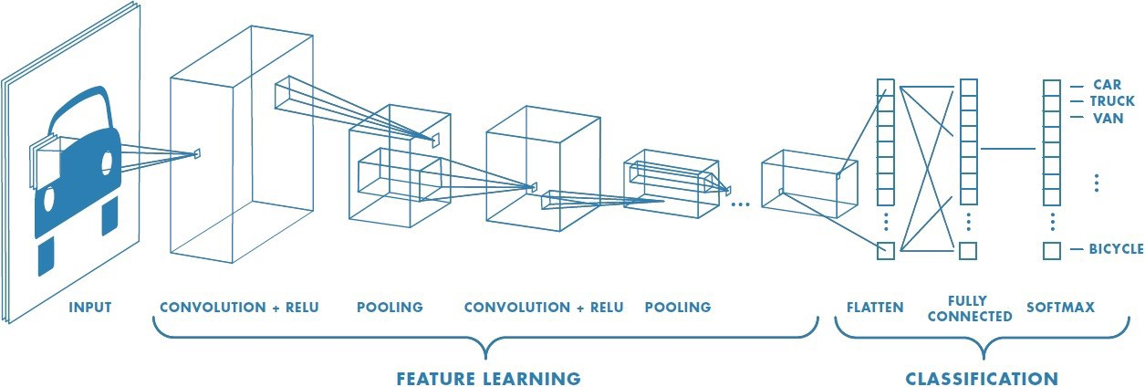
Convolutional neural networks (ConvNets/CNNs)
Source: https://towardsdatascience.com/a-comprehensive-guide-to-convolutional-neural-networks-the-eli5-way-3bd2b1164a53

Slide 9
Exercise 1: What AI do you know?
What examples of AI successes do you know?
  Please write them down
What AI techniques do you think they use?
Consider such areas as
  Image recognition
  Voice recognition
  Natural language processing
  Uses for creativity
What about law? – Any known successes?

Slide 10
References – Introductions
Greenleaf & Chung Readings on AI and on 'AI & Law'
Introductions to AI
  Melanie Mitchell Artificial Intelligence – A Guide for Thinking Humans (Pelican 2019)
  Margaret Boden Artificial Intelligence – A Very Short Introduction (OUP 2016)
AI and law
  Kevin Ashley Artificial Intelligence and Legal Analytics (Cambridge, 2017) – emphasis on case-based reasoning
  Michael Legg & Felicity Bell Artificial Intelligence and the Legal Profession: A Primer (flipstream, UNSW Faculty of Law, 2018)
Textbook on AI techniques (advanced)
  S Russell and P Norvig Artificial Intelligence: A Modern Approach (3rd Ed) (Pearson, 2016) (Ch 1 is an introduction; final chapter also valuable)

Slide 11
DataLex & AustLII – Background
DataLex Project (1984–) predates AustLII (1995 –)
  Developed AI tools for law in the pre-Internet ‘expert systems’ era
New DataLex Project (2017-) is AustLII’s future role in AI
  Further developing DataLex inferencing tools to build legal KBs
  Integrating these tools with all forms of content on AustLII
  Assisting users to build and maintain sustainable free legal advisory systems
  Providing ‘AI infrastructure’, rather than directly building applications
The DataLex Community is part of AustLII Communities
  Location of most resources used in this course (and DataLex/PLTX2040 web pages)
  Start with a quick demonstration of what we are aiming to do today: ELECTKB
  After today, you can develop and test your own apps with any of these features

Slide 12
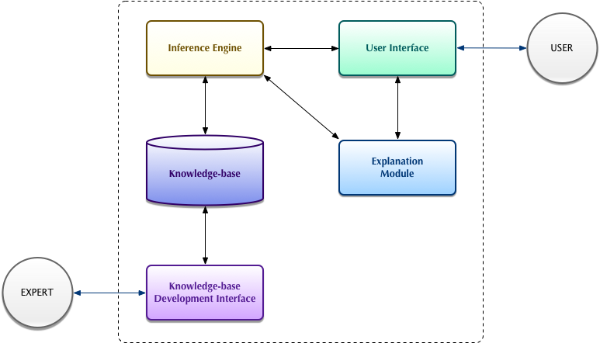
Components of an ‘Expert System’

Slide 13
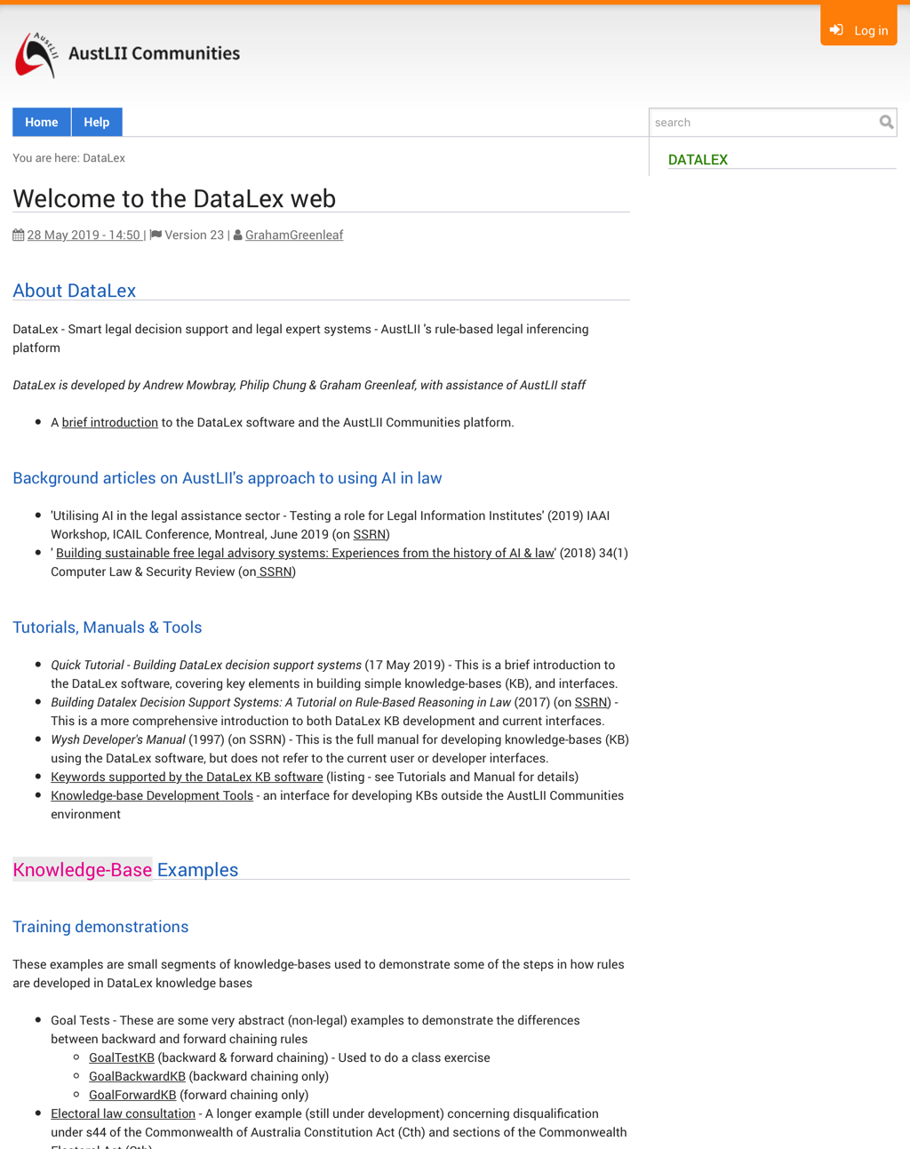
DataLex within AustLII Communities
http://austlii.community/wiki/DataLex/

Slide 14
15 principles for sustainable legal apps
DataLex article ‘Building Sustainable Free Legal Advisory Systems: Experiences from the History of AI & Law’ (2017)
This article suggests 15 ideas that remain relevant to building sustainable free legal advisory systems
  Many of them are also relevant to developing commercial systems
Three themes in this approach are the need for:
  Explanations based on the sources of law (1-5) – when running
  Self-sufficiency by legal advice providers (6), (15) – when developing
  Transparency between code and sources, in both the KB, and the app in operation (7-14) – for developing, updating & auditing
An introduction to these arguments follows…

Slide 15
Summary: 15 principles for sustainable legal app development
Law is not ‘just another problem domain’
Expertise is relative
No AI tool suits all types of problems
Start with legislation, not case law
Aim to handle complexity
Users organisations should maintain their own knowledge-bases
Use declarative knowledge representations where possible
Isomorphism is desirable
Quasi-natural-language knowledge-bases avoid repetitive coding
Propositional representation is enough for most tasks
Inferencing is not enough for decision support
Semi-expert systems and users collaborate
Legal expertise can and should be captured by multiple means
Automate hypertext linking, and searches, from knowledge-bases
Collaborative knowledge-bases can aid scaling-up

Slide 16
1. Law is not ‘just another problem domain’
Law is a difficult and unusual problem domain
  Unique relationship b/w legal sources and reasoning. Many other domains involve modeling physical laws or expertise about physical events. Legal sources are unique authoritative human artifacts, and do not (directly) model the physical world.
At least 5 types of legal expertise may be modeled:
  (i) formal advice on the correct interpretation of the law;
  (ii) strategic advice eg % chance of litigation succeeding;
  (iii) document generation, complying with the law;
  (iv) smart litigation/transaction systems;
  (v) smart retrieval and extraction from huge collections.

Slide 17
1. Law is not ‘just another problem domain’ (cont.)
DataLex approach focuses on (i) formal legal advisory systems: conclusions supported by legally convincing reasons based on demonstrable sources.
  DataLex primarily uses ‘symbolic AI’ (supplemented by procedural document generation, data mining and NNDA)
    Document generation (iii) has many similarities
  models (ii), (iv) & (v) are more likely to use ‘connectionist’ tools (neural nets, machine learning + very big data sets)
    Intended to deliver successful results, not explain reasoning

Slide 18
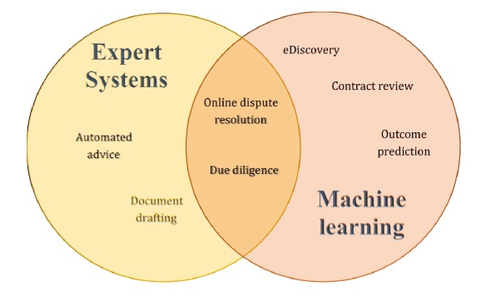
Some legal applications of AI
(Figure from Legg & Bell, p. 13)

Slide 19
2. Expertise is relative
‘Expert’ depends on context
  resource limitations define ‘expertise’ by context
    Including both legal and computing expertise, and access to data
  particularly applicable to free advice providers
  assumption behind the DataLex approach
‘This problem appears to be beyond the expertise of this system’
  successful advice, triaging human expertise to where needed most
  many system should include this at some point

Slide 20
3. No AI tool suits all types of problems
Fundamental question:
  is prediction of a ‘correct’ (useful) answer sufficient?
  or are justifications based on legal sources required?
Answer determines which types of tools can be used.
  machine learning (ML), neural networks etc cannot as yet explain their answers in human terms
  Eg automated document discovery systems, based on ML, can work well because
    they only need to predict if a document is likely to be relevant, but not explain why;
    training sets (with labels as to relevant / irrelevant) are affordable to produce

Slide 21
Eg Machine learning [ML] is rarely relevant to legal advice / decision support systems
Micha Grupp (Law, Frankfurt U.) ‘The factors that have fueled the AI-discussion in the last 7 years are of (almost) no relevance for AI in law.’ He says there are 5 ways in which ‘We do NOT have the necessary data for training legal machine learning algorithms’ for …
‘Formalization’ – We cannot formalise most legal terms.
‘Labels’: eg photo recognition software only works if photos come with labels; ‘Training sets’ require labels and are costly.
‘Data Quality’: eg contracts made under different laws are useless; ditto decisions under different regs.
‘Ontological Data’: There are no accepted ontologies for law, even though we have complex hierarchies in our heads.
‘World Knowledge’: Applying law requires unpredictable amounts of real-world knowledge [‘common sense’]
Micha Grupp ‘25 facts about AI & Law you always wanted to know (but were afraid to ask)’ Medium, 7 April 2019
BUT some argue that very large data sets and new algorithms may overcome these ‘knowledge acquisition bottlenecks’, even in law

Slide 22
Implications of Grupp’s arguments
Should not conclude we can’t do anything, but
  We can’t expect to fully automate KB construction
  We must allow for significant user input in system operation
  Good training sets will be expensive to build and difficult to map to raw data
    Case-based reasoning theorists (eg Ashley) have known this for 40 years
  How can you find large (training) data sets where both the labels and the outcomes can be determined automatically? (unsupervised learning)

Slide 23
4. Start with legislation, not case law
Can sustainable free access systems use case-based reasoning?
  A principal focus of AI & law research for 40 years (see 15 vols of ICAIL Proceedings 1987-2017)
  Theoretical basis still in dispute, no agreed approach
  Identification/encoding of attributes in cases is costly
    Encoding methods may apply only to narrow areas of law
    Ashley’s ‘cognitive computing paradigm’ assumes that a significant corpus of cases is available from which attributes can be extracted
DataLex approach is pragmatic, with 3 alternatives:
  Most practical: use links/searches over AustLII to alert users when case-based reasoning is required, and assist them to get to the cases needed to resolve a question.
  Represent definitive cases as rules, with links to supporting texts
  PANNDA approach (Manual, Ch 7) of reasoning from examples in very specific areas – but with links to cases for & against essential
Not ‘don’t do it’, just ‘handle with care’

Slide 24
Extract from Finder’s Cases KB (DataLex PANNDA)
EXAMPLE Armory v Delamirie [1722] EWHC KB J94 PROVIDES
the finder wins ONLY IF
the finder was not the occupier of the premises AND
the chattel was not attached AND
the non-finder was not the owner of the real estate AND
the non-finder was not the owner of the chattel AND
there was a bailment of the chattel AND
there was not a term in a lease which mentioned found items AND
there was not a master-servant relationship between the parties AND
the chattel was not hidden AND
there was not an attempt to find the true owner of the chattel AND
there was prior knowledge of the existence of the chattel
EXAMPLE Bridges v Hawkesworth (1851) 21 LJQB 75 PROVIDES
the finder wins ONLY IF
the finder was not the occupier of the premises AND
the chattel was not attached AND
the non-finder was the owner of the real estate AND
… [ATTRIBUTES CONTINUE]
A recent case: A group using metal detectors found a medieval horde, on grounds of a large estate. They did not notify the Council, in breach of the law.

Slide 25
5. Aim to handle complexity
Good to start with simple problems, BUT
Computers can out-perform humans in handling (some) complexity in a thorough way
  complexity is the boring part of expertise
  ‘capture complexity once only’ is a good aim
Rule-based reasoning can be ideal for this
Examples
  15 ways the Privacy Commissioner can avoid making a decision (later)
  many ways to be ineligible for election under s44 (Demonstration)

Slide 26
Legislation systems in practice
Both business (‘Business Process Compliance Systems’) & government (‘Law as Code’) are building legislation-based systems.
  Researchers like Ashley (p. 56, Chs 2 & 9) agree that there is no need to develop full-scale statutory interpretation systems for successful apps.
‘Law as Code’ movement in government
  Significant project teams work on implementing legal requirements in systems for use by the public (eg occupational licensing), in New Zealand, NSW and other jurisdictions.
  They also try to get legislative offices to draft more ‘code friendly’ laws.
  See ‘Law as Code Groups’ in the Reading Guide
‘Business Process Compliance Systems’ community
  There is developed movement in the US and elsewhere developing standards for combining business processes and legislative rules
  See ‘Business Process Modeling’ in the Reading Guide

Slide 27
Extract from Constitution Act s44 KB (DataLex)
RULE Constitution - Section 44 PROVIDES
section 44 of the Constitution applies ONLY IF
section 44(i) of the Constitution applies OR
section 44(ii) of the Constitution applies OR
section 44(iii) of the Constitution applies OR
section 44(iv) of the Constitution applies OR
section 44(v) of the Constitution applies
RULE Constitution - Section 44(i) PROVIDES
section 44(i) of the Constitution applies ONLY IF
the nominee is under an acknowledgment of
allegiance, obedience, or adherence to a
foreign power OR
the nominee is a subject of a foreign power OR
the nominee is a citizen of a foreign power OR
the nominee is entitled to the rights or
privileges of a subject or a citizen of a
foreign power

Slide 28
6. Users organisations should maintain their own knowledge-bases
Expert systems paradigm = domain expert(s) + knowledge engineer + KB program (shell)
  Lawyers assume to know nothing of KB construction, only of law
  But Knowledge Engineers were rare & expensive, + ignorant of law
The Knowledge Acquisition Bottleneck
  key problem of previous AI & Law
    Time/cost to capture legal expertise in obscure formalisms (Prolog; LISP)
    Time/cost to update expertise when law (frequently) changes
  Endemic, except if ML/training sets (labeling is costly) apply
Becomes desirable/necessary for lawyers to build/maintain their own knowledge-bases
  Particularly for those with limited financial resources
  May also overcome the timeliness problem
The question then is: How is it possible in practice to reject the expert system paradigm?
-> 7-15 suggest how

Slide 29
7. Use declarative knowledge representations where possible
Declarative knowledge representations (KBs): state domain knowledge as rules, but not the order of application
  The program (shell) determines the order of rule evaluation
  Contrast: Procedural knowledge representations combine domain knowledge +its order of application (eg ‘flow charts’; decision trees)
Declarative KBs are preferable wherever possible for law
  Legal procedural steps may be best as procedural code
  Document generation (Manual Ch 6) also requires them
  Complex KBs: likely to be mainly declarative, partly procedural
Declarative rules in KBs are by:
  Backward chaining rules: a goal is specified and the program evaluates rules in the order that will most efficiently give a value for the goal
  Forward chaining rules: all known facts are applied to evaluate rules until a value for the goal is obtained, or the facts are exhausted (they operate ‘silently’, don’t ask questions)
  Evaluation may be simultaneously backward and forward chaining (DataLex)
    This is the preferable mode

Slide 30
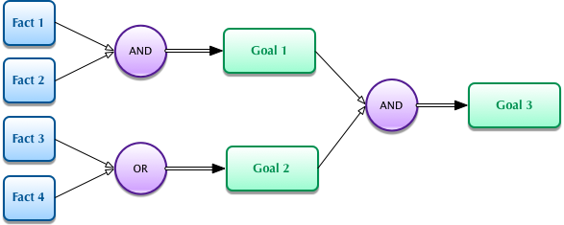
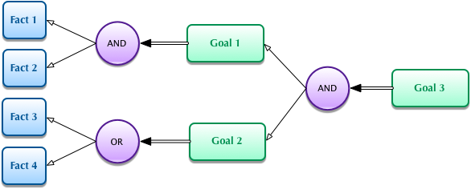
Forward chaining and backward chaining rules

Slide 31
Exercise 2: Backward and forward chaining rules
    Aim: To work out if D is true/correct, on the facts given on the next slide;
      First, do so on paper, noting which rules you evaluate, in which order
      Second, run the Goaltest program below, and note its order of evaluation (use the ‘Why’ and ‘How’ features to see what it is doing.
Goaltest (forward and backward chaining)
  Why does DataLex say C true when E is true?
Note: DataLex’s order of evaluation is
  top-down, including when two rules have the same goal
  L -> R within a rule, even if unnecessary (no ‘look ahead’)

Slide 32
‘Goaltest’
Goal: To work out if D is true/correct or not
Rule Conditions Conclusion
Rule 1 E and F A
Rule 2 A and (B or C) D
Rule 3 E or G C
Rule 4 H and G and C and not F A
Rule 5 F and not E not D
Facts
E, H and G are each correct (true)
F and B are each not correct (false)

Slide 33
Two other methods of rule evaluation
(Optional – advanced)
‘Goal Tests’ provides three methods of rule evaluation
  Here are two other versions you can test if you wish, to see how they differ from the default of combined backward & forward chaining in GoalTest
GoalBackward (uses back chaining only)
  Work out why the evaluation is different from the GoalTest version
GoalForward (uses forward chaining only)
  Answer questions in UPPER CASE (case sensitive)

Slide 34
Examples of a declarative & a procedural rule
DECLARATIVE RULE
GOAL RULE Eligibility for Nomination to Federal
Parliament PROVIDES
the nominee is entitled to be nominated for election
to federal parliament ONLY IF
the nominee is entitled to be nominated under
section 163 of the Commonwealth Electoral Act
1918 AND
section 164 of the Commonwealth Electoral Act 1918
does not apply AND
section 44 of the Constitution does not apply
PROCEDURAL RULE Demonstration: Will Generator
GOAL DOCUMENT Last Will & Testament PROVIDES
IF the person making the Will is legally capable of
making a Will THEN
BEGIN
CALL Disclaimer
CALL Preamble
CALL Revocation
CALL Contemplation of Marriage
CALL Sole Beneficiary
CALL Attestation
END
ELSE the person making the Will should not make a Will

Slide 35
8. Isomorphism is desirable
Isomorphism: as close as possible to a one-to-one correspondence between legal sources and knowledge-base (KB)
  It is only an ideal, can never be achieved fully
Advantages: essentially Qs of transparency at all development stages
  Easier to encode thoroughly by following legislative structure as closely as possible
  Easier for legal experts to audit whether the KB is an acceptable representation of the law
  When law changes, easier to identify which part of KB to change/update
As KB becomes more complex, isomorphism becomes more valuable
Demonstration: Copyright Law KB (out of date on law) – text next slide

Slide 36
Extract from (somewhat) isomorphic KB
RULE Copyright Act 1968 - s29(1) PROVIDES
s29(1) applies ONLY IF
s29(1)(a) applies OR
s29(1)(b) applies OR
s29(1)(c) applies
RULE Copyright Act 1968 - s29(1)(a) PROVIDES
s29(1)(a) applies ONLY IF
the work is a literary work AND/OR
the work is a dramatic work AND/OR
the work is a musical work AND/OR
the work is an artistic work AND/OR
the work is a published edition AND
reproductions of the work have been supplied
(whether by sale or otherwise) to the public
RULE Copyright Act 1968 - s29(2) PROVIDES
reproductions of the work have been supplied (whether by sale or otherwise) to the public ONLY IF
reproductions of the whole of the work have been supplied (whether by sale or otherwise) to the public
/* Added to give effect to: (2) In determining, for the purposes of paragraph (1) (a),
whether reproductions of a work or edition have been supplied to the public, section 14 does not apply.
*/
RULE Copyright Act 1968 - s29(1)(b) PROVIDES … [TEXT CONTINUES]
COPYRIGHT ACT 1968 - SECT 29
Publication
(1) Subject to this section, for the purposes of this Act:
(a) a literary, dramatic, musical or artistic work, or an edition of such a work, shall be deemed to have been published if, but only if, reproductions of the work or edition have been supplied (whether by sale or otherwise) to the public;
(b) a cinematograph film shall be deemed to have been published if, but only if, copies of the film have been sold, let on hire, or offered or exposed for sale or hire, to the public; and
(c) a sound recording shall be deemed to have been published if, but only if, records embodying the recording or a part of the recording have been supplied (whether by sale or otherwise) to the public.
(2) In determining, for the purposes of paragraph (1)(a), whether reproductions of a work or edition have been supplied to the public, section 14 does not apply.

Slide 37
9. Quasi-natural-language knowledge-bases avoid repetitive coding
Representations of rules in logic programming languages (eg Prolog or LISP) are powerful but have disadvantages
  Legal experts cannot audit/understand the rules part of the KB
  Both dialogues (questions) and explanations/conclusions (which are in English etc) are separate from the rules; isomorphism is largely lost
  These three can all get ‘out of synch’, particularly when the law changes
Alternative: quasi-natural language representations
  DataLex uses an English-like symbolic representation (Manual chapter 3)
  All representation is in the rules: no separate questions or explanations
  Faster to develop, as no repetitive coding; higher isomorphism
  Demonstration: run the FOI consultation, testing run-time options (Why?; How?; What if?; Report etc) All are generated automatically from KB.

Slide 38
Examples of dialogue & explanations generated automatically from s29 code (previous slide)
1) What is the name of the work ?
> The Lord of the Rings
2) Is The Lord Of The Rings a literary work ?
> Why?
This will help determine whether or not s29(1)(a) applies.
2) Is The Lord Of The Rings a literary work ?
> Yes
3) Have reproductions of the whole of The Lord Of The Rings been supplied (whether by sale or otherwise) to the public ?
> Yes
4) Is the publication merely colourable (not intended to satisfy the reasonable requirements of the public) ?
> No
5) Is the conduct relied upon to constitute publication the performance of The Lord Of The Rings ?
> No
6) Is the conduct relied upon to constitute publication the supply (whether by sale or otherwise) to the public of records of The Lord Of The Rings ?
> Why?
This will help determine whether or not the conduct relied upon to constitute publication is listed in s29(3).

Slide 39
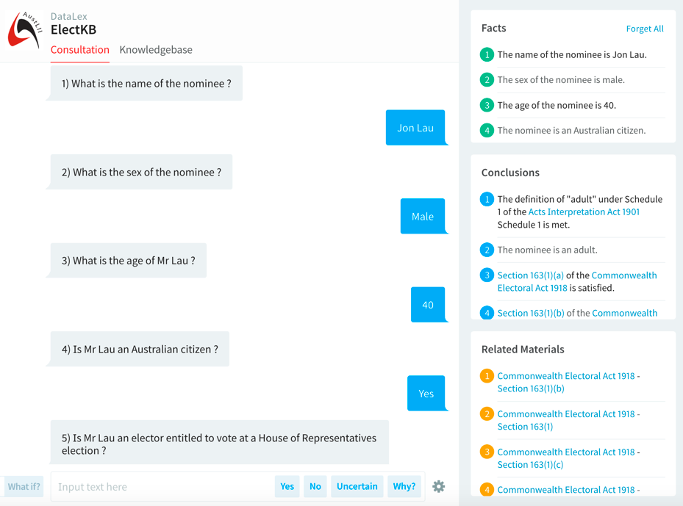
DataLex UI: Consultation, Facts, Conclusions, Related Materials

Slide 40
9. Quasi-natural-language KBs (2): Debugging
  De-bugging tools for DataLex KBs (Manual part 2.5)
    Demonstration: Go to the FOI consultation again
  Run ‘Check Default Fact Translations’
    Every attribute & named subject found in a KB rule is listed in 3 forms: interrogative; positive assertion; negative assertion
    Check visually to see that they have translated properly
  Run ‘Check Fact Cross References’
    Every attribute and named subject in the KB is listed in alpha order
    The name of each rule in which the attribute is used is listed under it
    Check visually for use in error of similarly named but not identical attributes
  Observe rules running and transcript consultations (Manual, 8.10)
  See rules being evaluated as they run (select gear wheel, bottom R)
  Generate a Transcript of whole consultation (text or visual)

Slide 41
10. Propositional representation is enough for most tasks
Predicate calculus (1st order logic), where multiple instances of the same variable can have different values, is only infrequently required.
  Extremely difficult to use a quasi-natural language knowledge representation to implement a full predicate logic system
  Very difficult for legal experts to understand / modify
Others (eg Bench-Capon) have similarly concluded that propositional logic is sufficient for most types of legal reasoning.
  Propositional logic originates with Aristotelian logic
DataLex software allows use of variable attributes (Manual 2.12) which are similar to some limited aspects of predicate (1st order) logic

Slide 42
11. Inferencing is not enough for decision support
Interpretation issues cannot be eliminated from KBs
  Many attributes will include terms which could require interpretation under unusual fact situations
  It is impossible to either anticipate, or provide rules to resolve, every such situation where interpretation may be needed
  Rule-based reasoning is very often not sufficient
Result: inferencing systems cannot be ‘closed’
  must allow & assist users to access legal sources, to interpret where required, and provide the answer back to the system
  must allow & assist users to check if law has changed since the KB was written
Exception: Some simple apps designed for end users might eliminate any ambiguous variables by simplification.

Slide 43
12. Decision support systems: Semi-expert systems and users collaborate
‘Robot lawyers’ are a misconception
Real model to aim for is a legal decision support system
  collaboration between a semi-expert computer system, and a semi-expert user
  control of a problem’s resolution alternates between them
System design, and extent of reliance on the user’s expertise, depend on extent of expertise of the intended/likely users.
  Priority required on enhancing the user’s interpretative skills

Slide 44
13. Legal expertise can and should be captured by multiple means
Knowledge-bases (KBs) are not the only form of capturing legal expertise (but are among the most sophisticated)
All technologies for utilising legal information allow legal expertise to be stored and re-used
  Traditional: citators, textbooks etc
All available new technologies (eg text retrieval, hypertext) should be utilised to store and re-use appropriate expertise
  Links from KBs in operation to sources/commentary, & stored searches to find updates, are embodied expertise
Integration between KBs and other forms of stored expertise, transparent to users, is the key to effective ‘open-ended’ apps
  This is the AustLII/DataLex approach

Slide 45
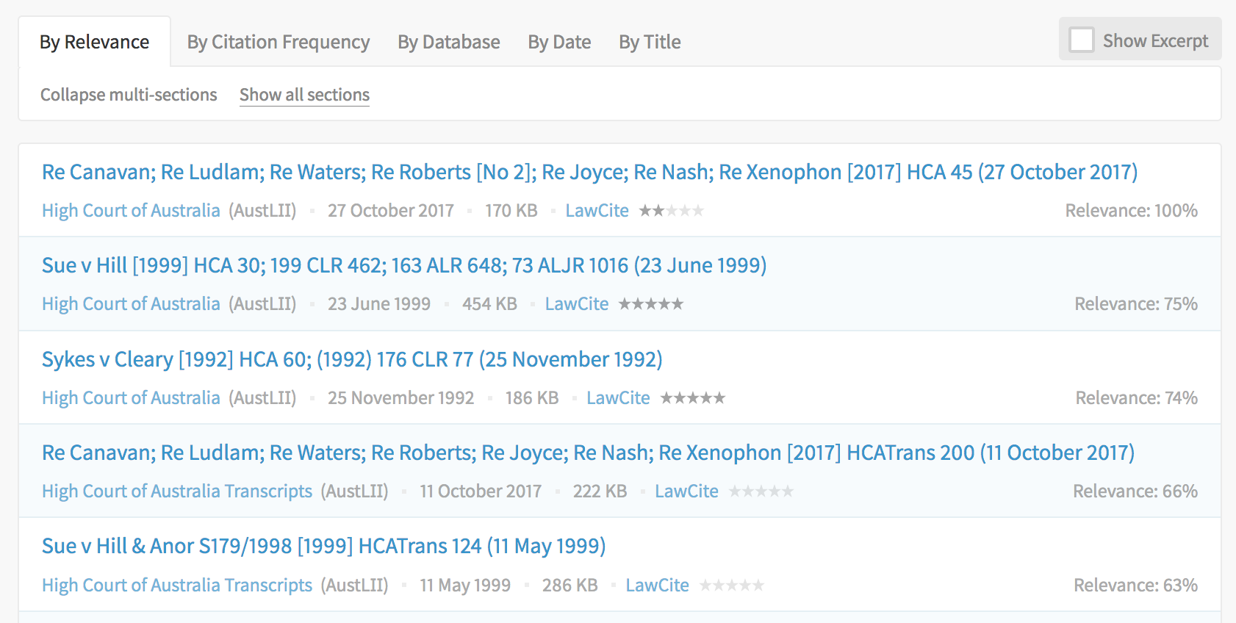
Constitution s44 KB – results of embedded search for “foreign power”

Slide 46
14. Automate hypertext linking, and searches, from knowledge-bases
Hypertext links and stored searches from dialogues and explanations increase user ability to answer questions and understand explanations
  to definitions, cases, citators, commentary etc
  can be both automated and hand-crafted (DataLex allows both).
Demonstration: FINDER application (Tyree, Mowbray)
  Although law is pre-1987, links to LawCite citator allow up-to-date cases to be found.

Slide 47
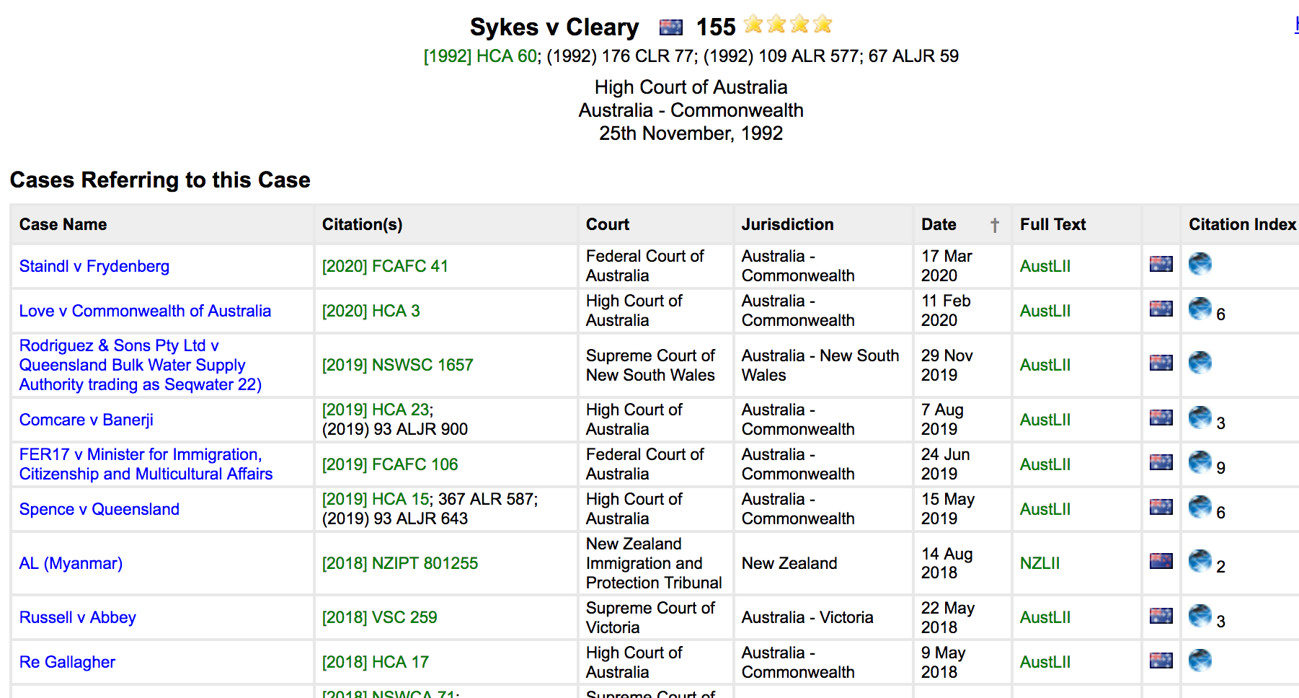
Constitution s44 KB – embedded link to Sykes v Cleary, then to LawCite showing cases later than KB

Slide 48
15. Collaborative knowledge-bases can crowd-source ‘scaling up’
Parts of knowledge-bases can be distributed across different websites, and written by different developers
  ‘INCLUDE’ is invoked remotely as part of a consultation
  Helps distribute maintenance and development costs
  One approach to the problem of ‘scaling up’ apps
DataLex ‘INCLUDE’ feature allows this
  DataLex Manual part 5.6 ‘Cooperative inferencing’
Examples using INCLUDEs are
  Privacy Act 1988 (Cth) procedures consultation
  Freedom of Information consultation (previous Demonstration)

Slide 49
15. …. ‘scaling up’: Possible approaches
The problem of ‘scaling up’ from demonstration-size systems to those which are useful in the real world
  An aspect of the ‘knowledge acquisition bottleneck’
  Must remember the test is utility, not completeness
Collaborative development of KBs?
  A closed wiki for ‘trusted’ developers (ie not open like Wikipedia)
Semi-automated conversion of statutes into KBs?
  Could some predictable aspects (eg definitions) be automated?
  Human checking and finishing necessary
Better KB construction tools to assist quick development

Slide 50
Recap: 15 principles for sustainable legal app development
Law is not ‘just another problem domain’
Expertise is relative
No AI tool suits all types of problems
Start with legislation, not case law
Aim to handle complexity
Users organisations should maintain their own knowledge-bases
Use declarative knowledge representations where possible
Isomorphism is desirable
Quasi-natural-language knowledge-bases avoid repetitive coding
Propositional representation is enough for most tasks
Inferencing is not enough for decision support
Semi-expert systems and users collaborate
Legal expertise can and should be captured by multiple means
Automate hypertext linking, and searches, from knowledge-bases
Collaborative knowledge-bases can assist ‘scaling up’

Slide 51
Exercise:
Which of these 15 ‘principles’ are relevant?
  Which of these 15 points are likely to be relevant to the development of legal apps that you might undertake (irrespective of which software you use), and which are not relevant? Why is that?
  Are there other general principles you would suggest should be added to any list of general principles for the development of applications?
  How different are principles relevant to assisting organisations providing free legal advice services likely be from those relevant to commercial or government organisation?

Slide 52
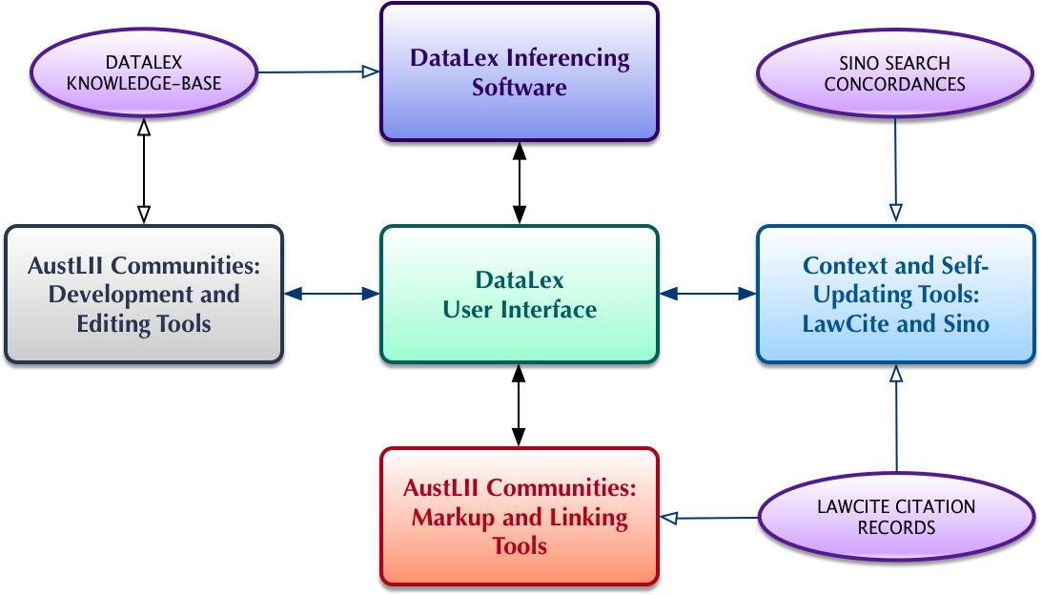
The DataLex system within AustLII Communities

Slide 53
Seminar 2: Developing a legal app using the DataLex software & AustLII
Before the Seminar
  Suggest you experiment with the tools, or read the Manual
Programme (2nd Seminar)
  10: 00 – 11:10 (70m) DataLex software and AustLII Communities ; Using the DataLex Developer’s Tools
    10 minute refreshment break
  11:20 – 12:30 (70m) DataLex Developer’s Tools; integrating a KB/app with AustLII content
  12:40 – 1:10 (30m) Discussion for as long as desired

Slide 54
Building a DataLex test app
On the DataLex Community page, under ‘Tutorials, Manuals & Tools’ there is a Quick Tutorial, full Tutorial, and the Manual
  Chapter 1 of the Manual covers everything in the tutorials – read it first
Start development at the Knowledge-base Development Tools (KB Tools) page
  http://www.datalex.org/dev/import/
Import a key section of the Act on which your app is based, and start editing it to make one rule
  ‘Comment out’ the rest of the section (/* … */)
  Use ‘Run Consultation’ asap, to check the rule works (+ turn on gear wheel)
  Use ‘Check Fact Cross References’ and ‘Check Fact Translations’
  Go back to the KB Tools page: fix and test; then add another rule

Slide 55
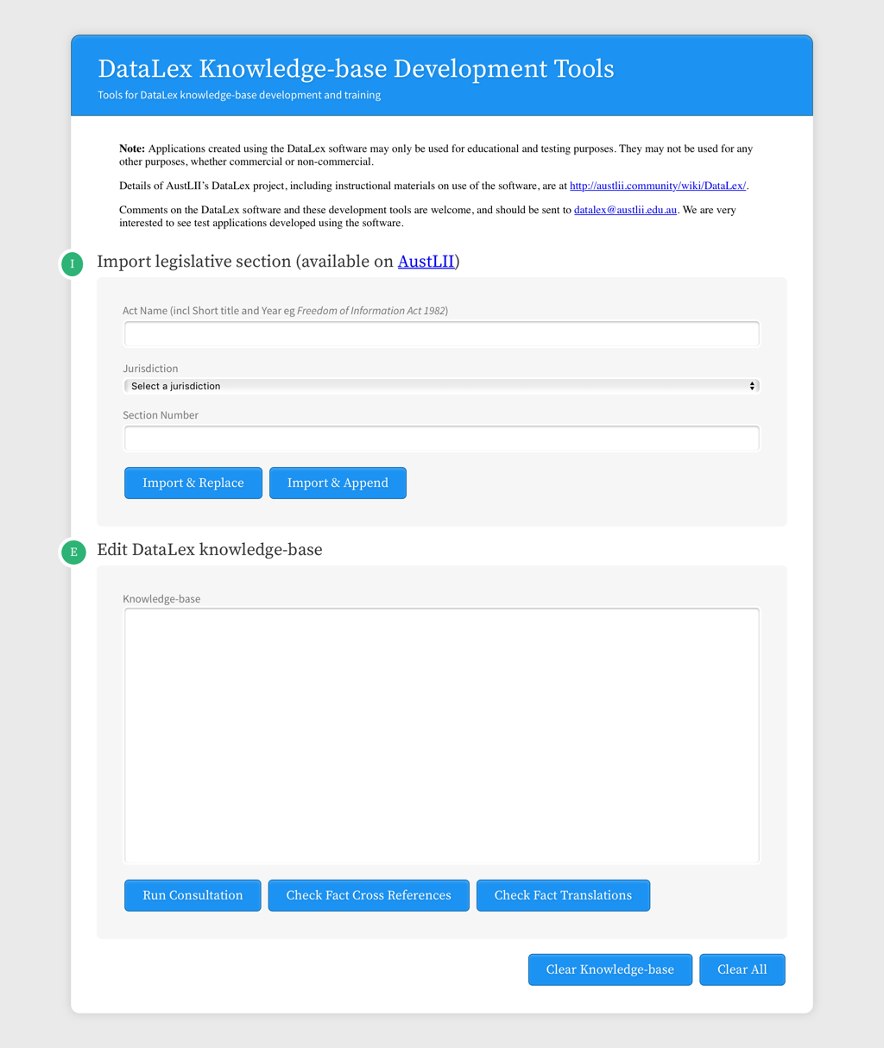
DataLex Knowledge-base Development Tools
http://www.datalex.org/dev/import/

Slide 56
Building a DataLex test app (cont.)
Try to add the following features to your app.
  At least one Keyword in addition to ONLYIF
  Make at least one rule a GOAL RULE
  At least one Named Subject (PERSON, THING etc)
  Include the full Act Name (including year) and section, in a rule (not just in its title), so as to automatically create a link to it
  Use LINK … TO … to manually create another link
  Look at the Manual, to find more Keywords that would be useful
Copy the text of your app from the KB Tools page to a Word file, email, or other method of keeping a copy, in case you want to use it again. You can’t save it from the KB Tools page

Slide 57
Demonstration of DataLex app development - Privacy procedures
Choice of problem domain:
  The Australian Privacy Commission can only make binding decisions (including compensation) on complaints about privacy under s52 Privacy Act 1988. But he/she only makes an average of 2 p/a (last 5 years).
  Appeals against s52 decisions to the Administrative Appeals Tribunal are possible under s96 Privacy Act.
  But first it is necessary to avoid having the Commissioner dismiss a complaint before making a s52 decision, or otherwise find a reason to not do so.
The aim is therefore to develop an app which will advise on how to ensure that the Commissioner makes a s52 decision that can be appealed.
Demonstration: Start a small app from the DataLex KB Tools page; then use INCLUDE to incorporate already-developed parts of the KB

Slide 58
A set of facts to test Privacy App
Tina Thumb applied for a personal loan from Payday Lenders Pty Ltd (‘Payday’) in July 2018. They required her to disclose sensitive information including her fingerprints. She complained immediately to them, but has still received no reply. There is no mediation service for these types of loans. She then complained to the NSW Dept of Consumer Affairs, but they have not replied. Their legislation does not provide for the award of damages. After six months she complained to the Privacy Commissioner, and has answered all their enquiries. Tina’s lawyer advises that the Privacy Act is the most appropriate law for her complaint, and that the facts give a high likelihood that Payday has breached the Act.

Slide 59
DataLex References
AustLII Communities: DataLex http://austlii.community/wiki/DataLex/ – key DataLex papers, manuals etc
Greenleaf, Mowbray & Chung, ‘The Datalex Project: History and Bibliography’ (2018) https://ssrn.com/abstract=3095897
  or see linked bibliography at http://www2.austlii.edu.au/~graham/expert_systems.html

Slide 60
Questions and feedback
Graham Greenleaf - graham@austlii.edu.au
Philip Chung - philip@austlii.edu.au
General DataLex feedback - datalex@austlii.edu.au
DataLex

